Slide 1

Institutional Mechanisms for Gender Equality and Gender Mainstreaming
2018 study
Barbara Limanowska| Programme Coordinator Gender Mainstreaming EIGE

Slide 2


Area H of the Beijing Platform for Action: institutional mechanisms for gender equality and gender mainstreaming
The three strategic objectives are:
Create or strengthen national machineries and other governmental bodies
H1
Integrate gender perspectives in legislation, public policies, programmes and projects.
H2
Generate and disseminate gender-disaggregated data and information for planning and evaluation.
H3

Slide 3


Indicators
INDICATOR 1
Status of governmental responsibility in promoting gender equality
INDICATOR 2A, 2B
Personnel resources for gender equality
INDICATOR 3
Gender Mainstreaming
INDICATOR 4
Production and dissemination of statistics disaggregated by sex

Slide 4
Objectives of the study
✓
Collect up to date information on the institutional mechanisms for gender equality and gender mainstreaming in each of the EU-28 Member States
✓
Contribute to the improvement of the monitoring/evaluation tools for these three objectives
✓
Literature overview and survey

Slide 5
Indicator 1 — Status of governmental responsibility in promoting gender equality: 2018

Slide 6
Indicator 1 — Status of governmental responsibility in promoting gender equality: 2012, 2018

Slide 7
Indicator 1 – Sub-indicators
Sub-indicators EU -28 | 2012 | 2018
Highest responsibility for promoting gender equality at the governmental level | 1.75 | 1.75
Existence and permanence of a governmental body for promoting gender equality | 2 | 1.96
Level of location of the governmental body for promoting gender equality within the government hierarchy | 1.46 | 1.25
Functions of the governmental body for promoting gender equality | 1.93 | 1.88
Accountability and existence of governmental action plans for gender equality | 1.79 | 1.64
Total Indicator 1 | 8.93 | 8.48

Slide 8
Indicator 2a – Human resources of the governmental gender equality body (full time, round-year employees in person year): 2018

Slide 9
Indicator 2a – Human resources of the governmental gender equality body (full time, round-year employees in person year): 2012 and 2018
Figure: Employees of governmental gender equality body (per 1 000 000 population)
Source: EIGE 2018 and 2012 survey data. 2012 data not available for BG and MT. Population data covers 2018 and is from Eurostat [demo_pign]

Slide 10
Indicator 3 – Gender mainstreaming efforts: 2018

Slide 11
Indicator 3 – sub-indicators
Sub-indicators EU-28 | 2012 | 2018
Status of the government’s commitment | 1.4 | 1.52
Gender mainstreaming structures | 2.5 | 2.05
Commitment to and use of the methods and tools for gender mainstreaming | 4.5 | 3.84
Total Indicator 3 | 8.4 | 7.41

Slide 12
Conclusions
Inadequate government commitment to gender equality
Lack of transparency about human and financial resources
Gender mainstreaming addressed in an uneven way with an overall declining trend
Lack of commitment to produce and disseminate sex-dissegregated data.

Slide 13
Conclusions
Uneven results and growing gaps and difference between Member States
Mergers of equality bodies result in a lack of information about allocated resources
Gender mainstreaming stays on the level of rhetoric while the practical use of the methods and tools decline
Sex-dissagragated data even when collected is not properly disseminated.

Slide 14
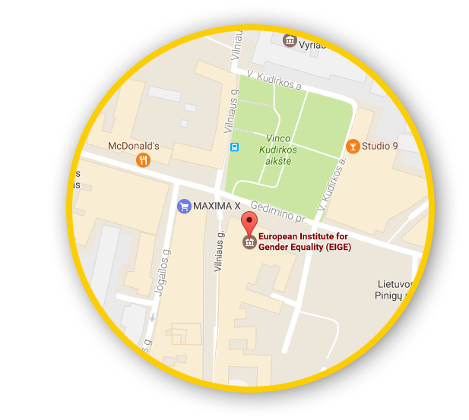





Let’s talk!
Connect with us!
eige.europa.eu
facebook.com/
eige.europa.eu
twitter.com/
eurogender
come in for a chat!
eige.europa.eu/
newsletter
eurogender.eige.
europa.eu
youtube.com/
user/eurogender
Gedimino pr. 16,
LT-01103 Vilnius,
Lithuania

